Slide 1

POLITECNICO DI MILANO

Slide 2

Goals and Functionalities
Allow the user to add an appointment
- Add the date and time through a calendar
- Add the location through a map
- Add a description
Provide a route to the user for reaching the appointments
- The user must reach on time his/her appointments
- The user chooses the starting location and time of the route
- The application provides a route for each objective to minimize: length, duration, number of changes, carbon footprint
- Each route is composed by more paths
- During strike days, public transportation must not be available
- Report and update unfavorable weather conditions
POLITECNICO DI MILANO

Slide 3
Goals and Functionalities
Allow the user to sign up and then login
- The system allow the login through e-mail and password or telephone number
- User registration is not mandatory, but unlocks some functionalities:
Preference Profile
Synchronization and backup
Weather forecast update
Available preferences
- Usable transport means
- Priority of transport means
- Maximum length on foot or bycicle
- Timeslot of validity
- Flexible lunch and other breaks
Allow the user to report strikes, suggestions or malfunctions
POLITECNICO DI MILANO

Slide 4
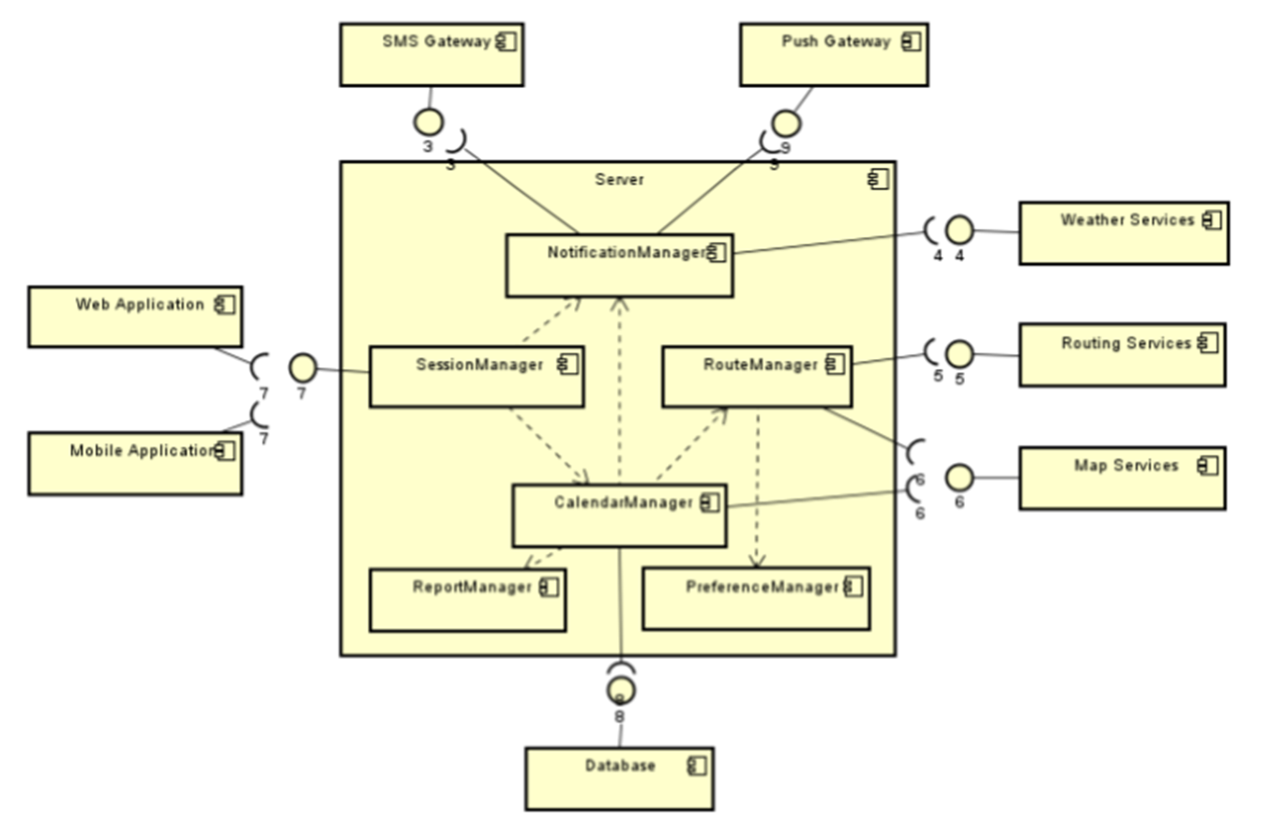
Components
POLITECNICO DI MILANO

Slide 5
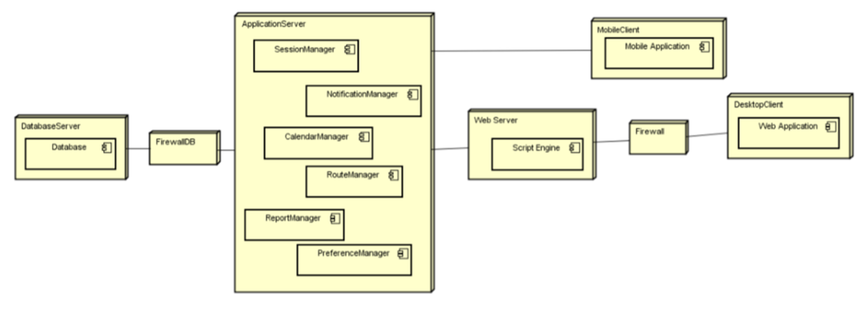
Deployment
POLITECNICO DI MILANO

Slide 6
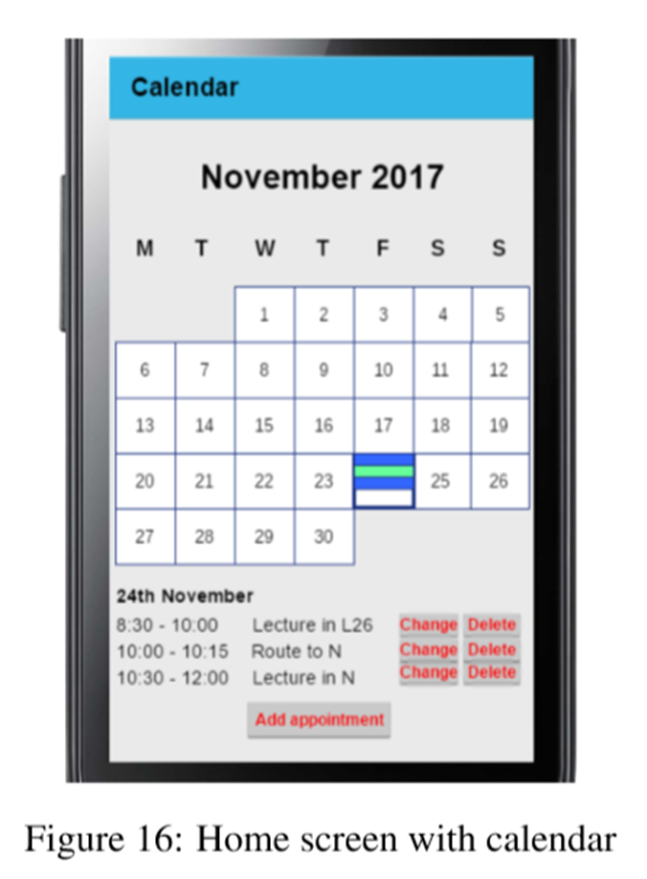
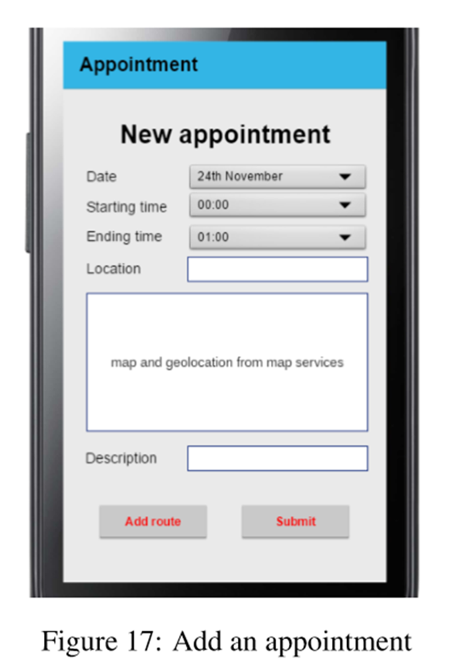
User Interface – Use Case
POLITECNICO DI MILANO

Slide 7
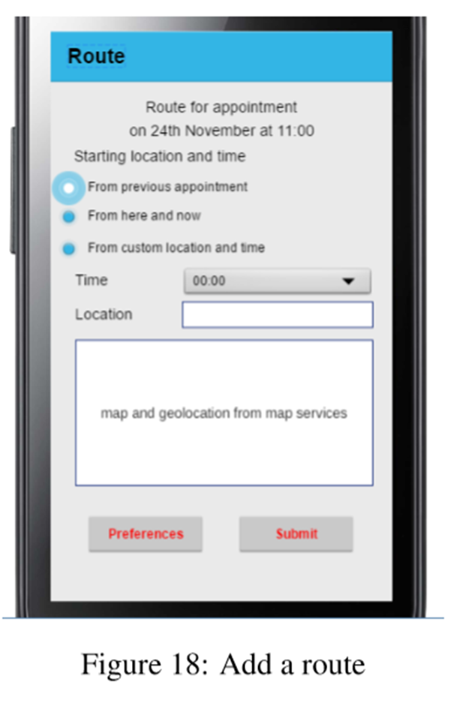
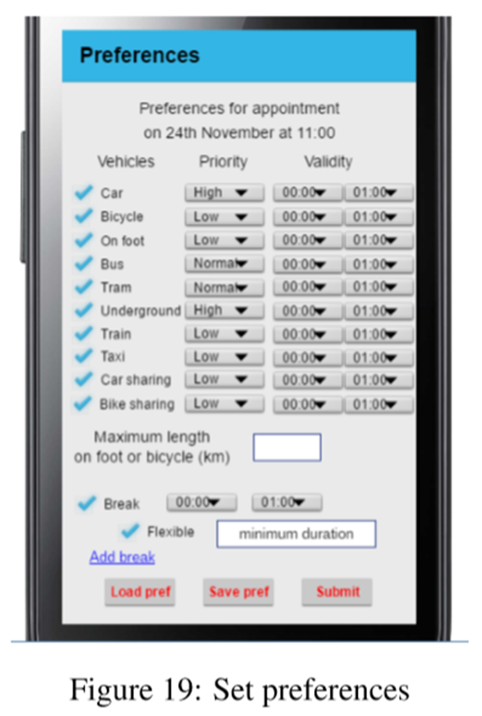
User Interface – Use Case
POLITECNICO DI MILANO

